Slide 1
DESIGN (ANTI-)PATTERNS
Coffee Break
Visitor

Slide 2
WHAT ARE DESIGN PATTERNS
A software design pattern is a general, reusable solution to a commonly occurring problem. It is not a finished design that can be transformed directly into source or machine code. It is a description or template for how to solve a problem that can be used in many different situations. Design patterns are formalized best practices that the programmer can use to solve common problems when designing an application or system.
Types
Creational (singleton, builder, lazy init, abstract factory, object pool etc.)
Structural (adapter, bridge, decorator, facade, composite, proxy etc.)
Behavioral (iterator, strategy, template method, visitor, command etc.)
Concurrency (thread pool, double checked locking, monitor object, reactor etc.)

Slide 3
VISITOR

Slide 4
VISITOR
GoF Definition
Represent an operation to be performed on elements of an object structure. Visitor lets you define a new operation without changing the classes of the elements on which it operates.
Concept
It should be possible to define a new operation for (some) classes of an object structure without changing the classes
Define a separate (visitor) object that implements an operation to be performed on elements of an object structure
Clients traverse the object structure and call a dispatching operation accept(visitor) on an element — that "dispatches" (delegates) the request to the "accepted visitor object". The visitor object then performs the operation on the element ("visits the element").
This makes it possible to create new operations independently from the classes of an object structure by adding new visitor objects (open/closed principle)

Slide 5
VISITOR
Double dispatch
Visitor pattern utilizes so called double dispatch
Standard OO languages support only single dispatch, that is the operation that is executed depends on the name of the request, and the type of the receiver
Double dispatch: the operation executed depends on: the name of the request, and the type of TWO receivers (the type of the Visitor and the type of the element it visits)
Done via combination of polymorphism and method overloading

Slide 6
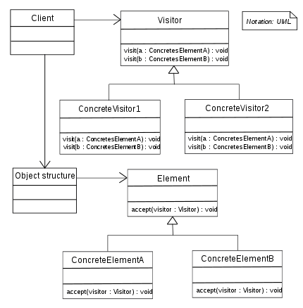
UML class diagram
Each element has accept(Visitor) method
Each Visitor has visit method overloaded per concrete Element
ConcreteElementA accepts ConcreteVisitor1 via visitor parameter
Calls visit(this), that means the overloaded method visit(ConcreteElementA)
Hence the double dispatch – depends on method name – visit, receiver1 – concrete class of ElementA, concrete visitor 1 decided on runtime (polymorphism)

Slide 7
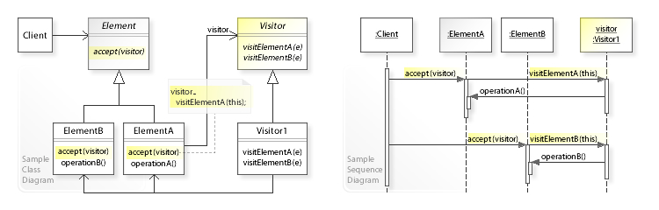
UML sequence diagram

Slide 8

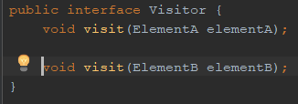
VISITOR
Example implementation
Create two elements
Create two visitors
Visit both elements with both visitors

Slide 9
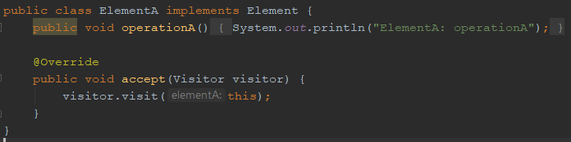
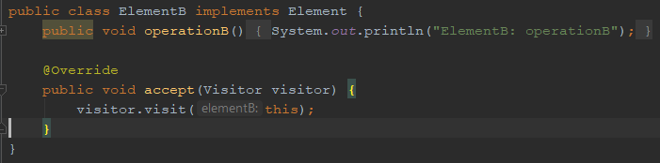
VISITOR
Example implementation Elements

Slide 10
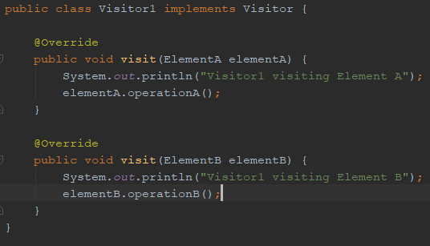
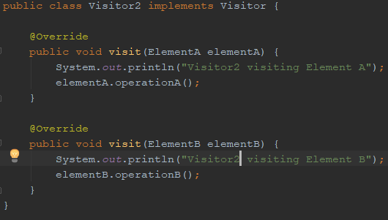
VISITOR
Example implementation Visitors

Slide 11
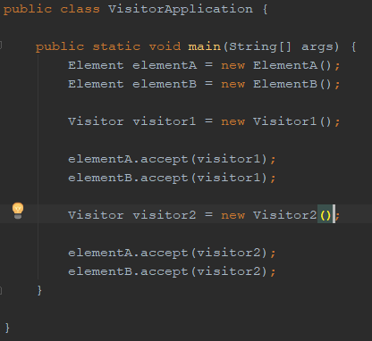
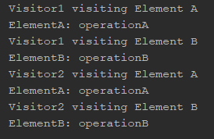
VISITOR
Example implementation Visitors

Slide 12
VISITOR
Example discussion
We can add new functionality by implementing new Visitor without modifying elements
Adding new element is painful – we need to add new visit method to the Visitor interface and implement it in each Visitor implementation
Works well with Composite pattern – Composite represents hierarchy of Elements, it accepts a Visitor and for each new operation requires implementing new Visitor
Useful when we can’t change the elements, let’s say they come from library, we add functionality by Visitor, however, this requires element to have accept method, otherwise we can use Wrapper (Adapter) pattern
an algorithm involves several classes of the object structure, but it is desired to manage it in one single location
an algorithm needs to work across several independent class hierarchies

Slide 13
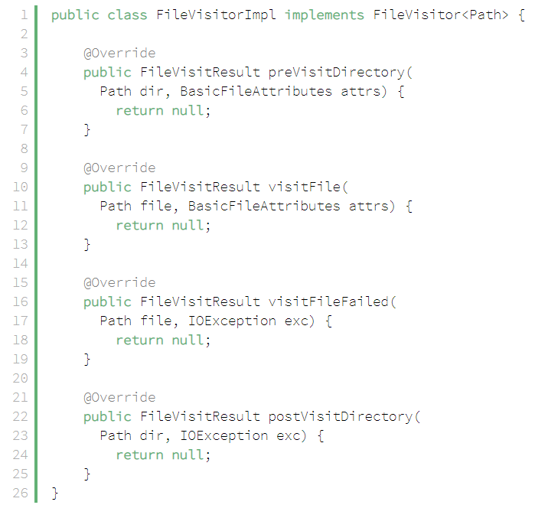
VISITOR
Real world examples – Java NIO FileVisitor

Slide 14
VISITOR
Java NIO FileVisitor
The element is the Path parameter
Has some additional parameters
Can return an enum that drives how should the algorithm behave
Can be implemented as a search over file system

Slide 15
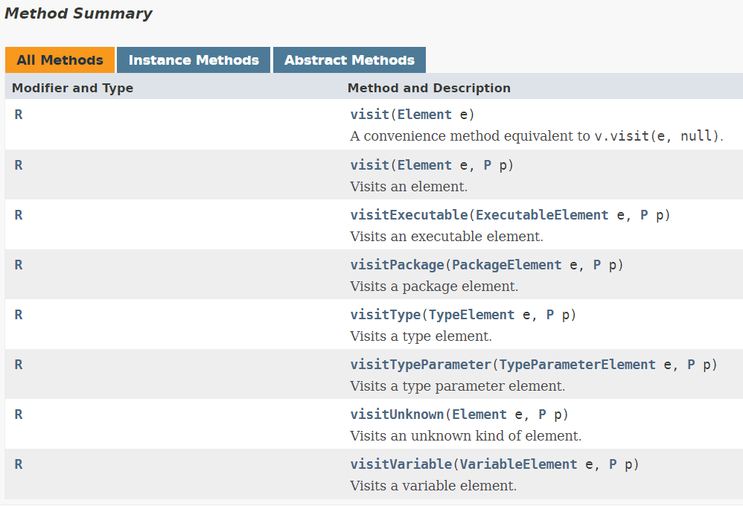
VISITOR
Java 8 Visitor for language features
https://docs.oracle.com/javase/8/docs/api/javax/lang/model/element/ElementVisitor.html

Slide 16
VISITOR
Real project example
ISSP project API documented via Swagger
Deep hierarchical structure of the request object, lots of constraints
Task – generate automated test for these API constraints – positive and negative cases
Swagger parser parses Swagger file into AST
Wrap nodes of AST into convenient structure with accept(Visitor) method
Positive case visitor – generates input that satisfy constraints
Negative case visitor – generates input that violate constraints

Slide 17
VISITOR
Further discussion
There are languages the support multiple-dispatch such as Common Lisp or C# via Dynamic language runtime which makes implementation of Visitor simplified
Instead of having overloaded method for each element subclass, there can be just one method with the Element interface and then switch using instanceof, not nice…
Use reflection https://www.javaworld.com/article/2077602/java-tip-98--reflect-on-the-visitor-design-pattern.html

Slide 18
VISITOR
Sources
https://en.wikipedia.org/wiki/Visitor_pattern
https://en.wikipedia.org/wiki/Double_dispatch
https://www.baeldung.com/java-visitor-pattern
https://www.baeldung.com/java-nio2-file-visitor
https://blog.jooq.org/tag/visitor-pattern/
https://www.javaworld.com/article/2077602/java-tip-98--reflect-on-the-visitor-design-pattern.html

Slide 19
VISITOR
Questions and discussion

